Slide 1

Feature Engineering: Enhancing Machine Learning Models
Machine Learning
ICE-4225
Group-11

Slide 2
Table of Contents
Introduction
Importance of Feature Engineering
Relevance in Real World Applications
What is Features
Categorial Features
One-Hot Encoding
Label Encoding
Target Encoding
Numerical Features
Min-Max Scaling
Textual Features
Bag of Words (BoW)
Time Series Features

Slide 3
Table of Contents
Types of Processes
Feature Creation
Domain Specific
Data Driven
Synthetic
Feature Transformation
Normalization
Scaling
Encoding
Transformation
Feature Extraction
Dimensionality Reduction
PCA
LDA
t-SNE
Feature Combination
Feature Aggregation
Feature Transformation
Feature Selection
Filter Method
Wrapper Method
Embedded Method
Feature Scaling

Slide 4
Table of Contents
Steps in Feature Engineering
Data Cleansing
Feature Iteration
Feature Split
Feature Engineering Techniques
Imputation
Mean
Median
Regression
K-Nearest Neighbors
Handling Outliers
Log Transformation
Binning
Feature Engineering with Text

Slide 5
Table of Contents
Data
TF-IDF
Word2Vec
Feature Engineering with Time Series Data
Feature Engineering Algorithms
Random Forest
XGBoost
Feature Engineering Tools
Feature Engineering Best Practises
Conclusion
Refererence

Slide 6
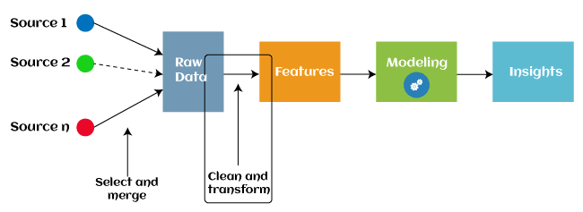
Introduction
Feature engineering is a fundamental concept in machine learning.
It involves the process of creating, selecting, and transforming features from raw data to enhance the performance of machine learning models.

Slide 7
Importance of Feature Engineering
Enhances Model Performance: Well-engineered features can significantly improve the accuracy and efficiency of machine learning models.
Addresses Data Challenges: Feature engineering helps address issues like noisy data, missing values, and dimensionality.
Simplifies Model Interpretation: Carefully designed features can simplify model interpretation and decision-making.

Slide 8
Relevance in Real World Applications
Healthcare
Feature engineering aids in patient diagnosis, disease prediction, and medical image analysis.
Finance
It is crucial in fraud detection, risk assessment, and algorithmic trading.
Natural Language Processing
NLP applications use feature engineering for sentiment analysis, text classification, and language understanding.
Computer Vision
Image recognition, object detection, and facial recognition systems benefit from well-engineered features.
E-commerce
Recommender systems and user behavior analysis rely on feature engineering for personalized recommendations.
IoT and Sensor Data
Feature engineering plays a vital role in sensor data analysis, predictive maintenance, and anomaly detection.

Slide 9
What Are Features?
Features are the individual characteristics or attributes that provide information about the data used in a machine learning model.
Features are the building blocks of predictive modeling, influencing the model's ability to make accurate predictions.
Features play a crucial role in shaping the performance of predictive models. They are the inputs that guide the model's decision-making process.
Choosing relevant and meaningful features can lead to better model understanding and interpretability

Slide 10

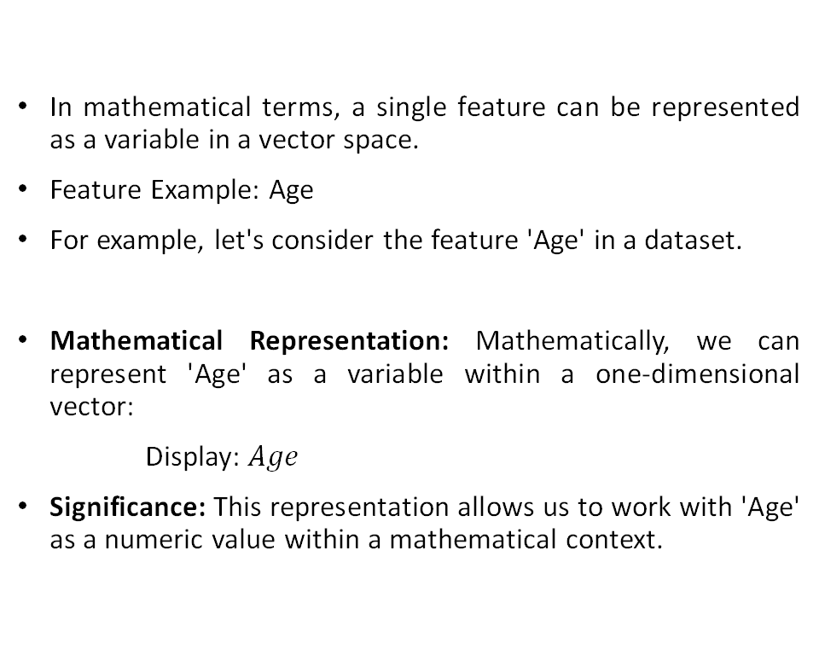
Mathematical Representation
In mathematical terms, a single feature can be represented as a variable in a vector space.
Feature Example: Age
For example, let's consider the feature 'Age' in a dataset.
Mathematical Representation: Mathematically, we can represent 'Age' as a variable within a one-dimensional vector:
Display: $Age$
Significance: This representation allows us to work with 'Age' as a numeric value within a mathematical context.

Slide 11
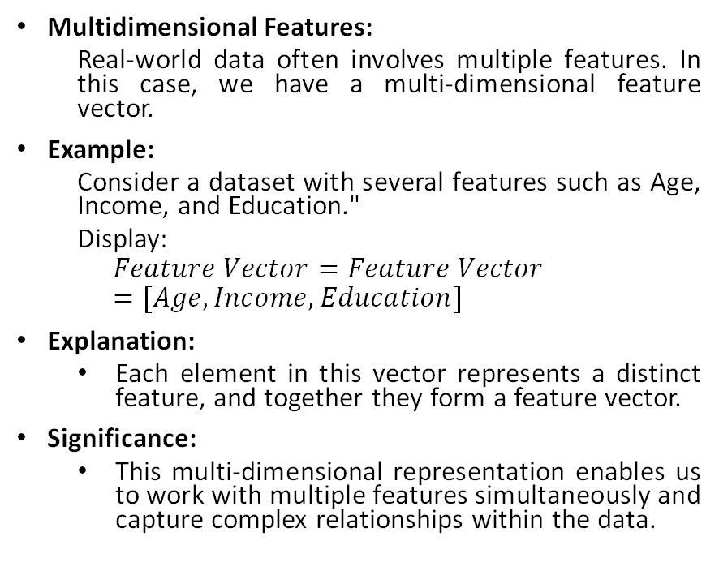
Mathematical Representation
Multidimensional Features:
Real-world data often involves multiple features. In this case, we have a multi-dimensional feature vector.
Example:
Consider a dataset with several features such as Age, Income, and Education."
Display:
$$Feature Vector=Feature Vector=[Age,Income,Education]$$
Explanation:
Each element in this vector represents a distinct feature, and together they form a feature vector.
Significance:
This multi-dimensional representation enables us to work with multiple features simultaneously and capture complex relationships within the data.

Slide 12
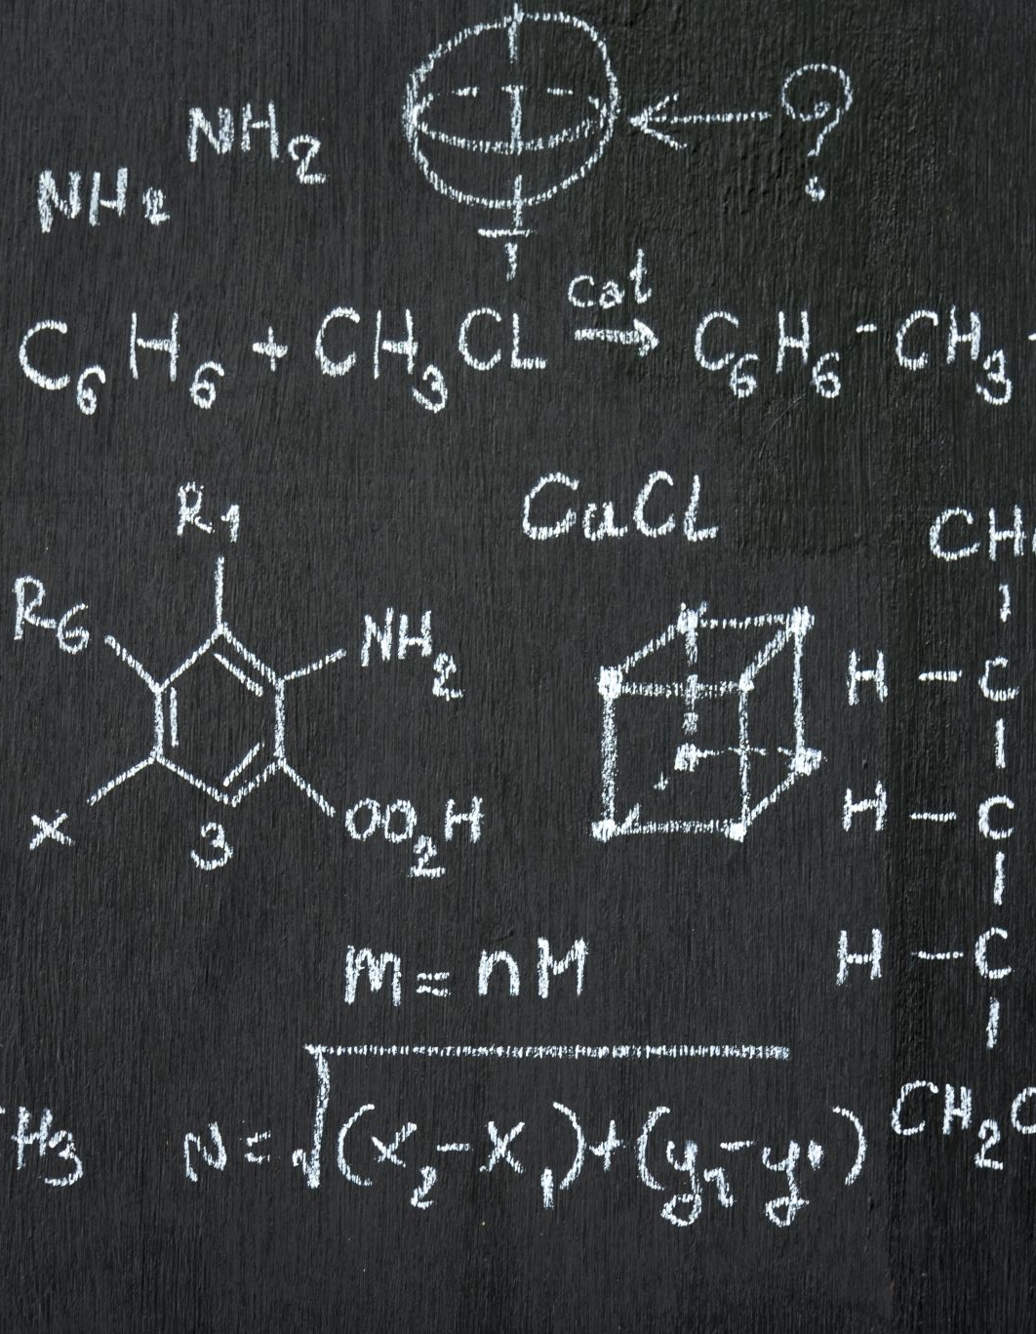
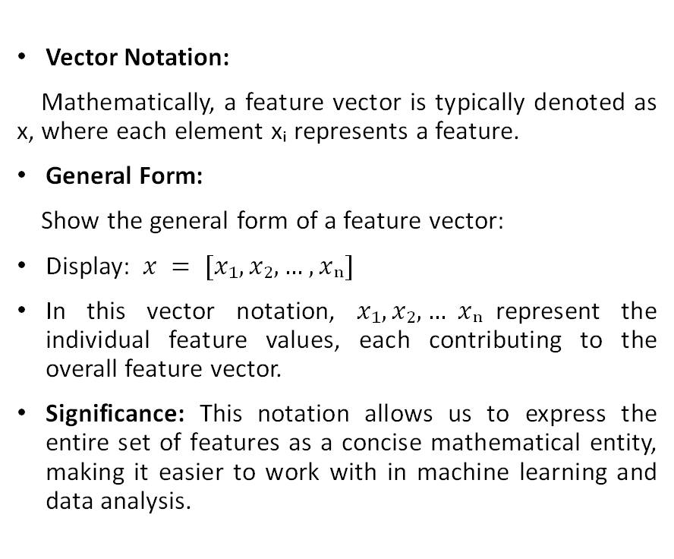
Mathematical Representation
Vector Notation:
Mathematically, a feature vector is typically denoted as x, where each element xᵢ represents a feature.
General Form:
Show the general form of a feature vector:
Display: $x = [x₁, x₂, …, xₙ]$
In this vector notation, $x₁, x₂, … xₙ$represent the individual feature values, each contributing to the overall feature vector.
Significance: This notation allows us to express the entire set of features as a concise mathematical entity, making it easier to work with in machine learning and data analysis.

Slide 13
Categorial Features
Categorical features represent distinct categories or labels. They are non-continuous and are often represented as strings or labels.
Mathematical Representation of Categorical Data: In mathematical terms, categorical data can be encoded using various techniques.
One common method is One-Hot Encoding.
Sample Data:
Item | Color | Size
A | Red | Small
B | Green | Medium
C | Blue | Large

Slide 14
One Hot Encoding
One hot encoding is the popular encoding technique in machine learning.
It is a technique that converts the categorical data in a form so that they can be easily understood by machine learning algorithms and hence can make a good prediction.
It enables group the of categorical data without losing any information.
Item | Red | Green | Blue
A | 1 | 0 | 0
B | 0 | 1 | 0
C | 0 | 0 | 1
In this table, we have sample data with feature: 'Color’. Each item is associated with a color and size category.
This technique is used to transform the 'Color' feature into binary vectors. Each unique color becomes a binary column, and the presence of a color is indicated by '1,' while '0' indicates absence.

Slide 15
Label Encoding
Label Encoding is a categorical data encoding technique that transforms categories or labels into numerical values.
Each unique category is assigned a unique numerical label.
Process:
Assigning Labels:
For a categorical feature, each unique category is assigned a numerical label.
Labels are typically assigned in a sequential manner starting from 0, 1, 2, and so on.
Transformation:
The original categorical feature is replaced with the numerical labels.
Machine learning algorithms can now process the data, as it's in a numeric format.
Example:
Consider a 'Size' feature with three categories: Small, Medium, Large. Label Encoding assigns labels as follows:
Small: 0
Medium: 1
Large: 2

Slide 16
Target Encoding
Target Encoding is a feature encoding technique used to convert categorical data into meaningful numerical representations based on the relationship with the target variable.
It's particularly valuable when dealing with classification tasks.
Process:
Data Preparation:
Start with a categorical feature that you want to encode.
Ensure you have a target variable for your machine learning task (e.g., binary classification).
Calculating Mean:
For each unique category within the categorical feature, calculate the mean of the target variable for data points within that category.
This is done by grouping data by category and computing the mean target variable value for each group.
Assigning Values:
Replace the original category labels with the calculated mean values.
The categorical feature is now encoded with meaningful numerical values based on their relationship with the target variable.
Example:
Consider a 'City' feature and a binary target variable 'Churn' (0 or 1):
New York: Target Mean = 0.25
Los Angeles: Target Mean = 0.10
Chicago: Target Mean = 0.15

Slide 17
Numerical Features
Numerical features represent continuous data that can take any value within a range. They are typically represented as real numbers.
Numerical data is mathematically represented as scalar values
Example: Scaling

Slide 18
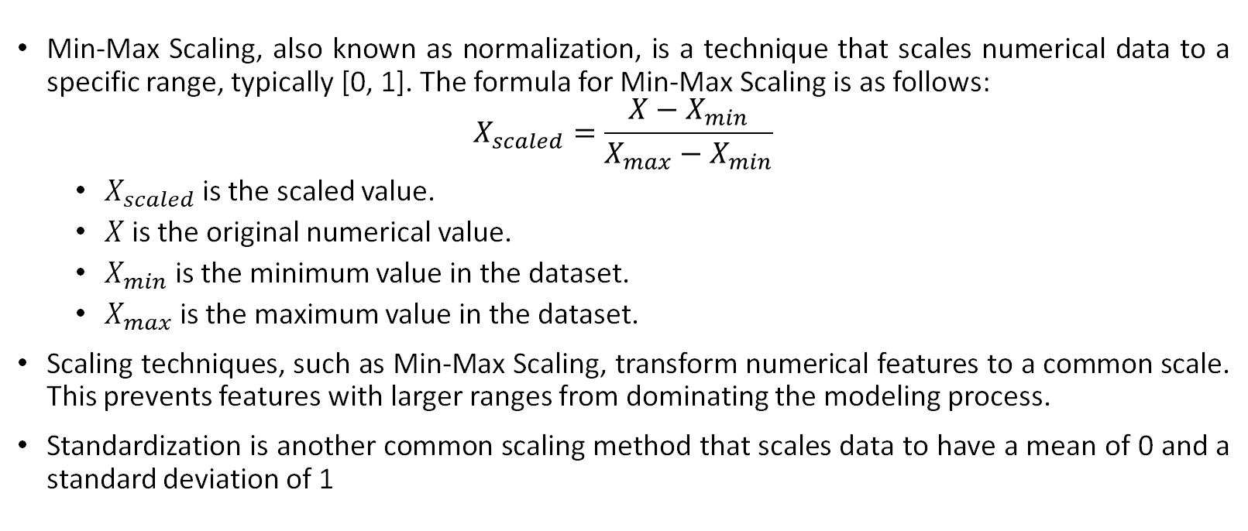
Min-Max Scaling
Min-Max Scaling, also known as normalization, is a technique that scales numerical data to a specific range, typically [0, 1]. The formula for Min-Max Scaling is as follows:
$$X_{scaled}=\frac{X−X_{min}}{X_{max}−X_{min}}$$
$X_{scaled}$ is the scaled value.
$X$ is the original numerical value.
$X_{min}$ is the minimum value in the dataset.
$X_{max}$ is the maximum value in the dataset.
Scaling techniques, such as Min-Max Scaling, transform numerical features to a common scale. This prevents features with larger ranges from dominating the modeling process.
Standardization is another common scaling method that scales data to have a mean of 0 and a standard deviation of 1

Slide 19
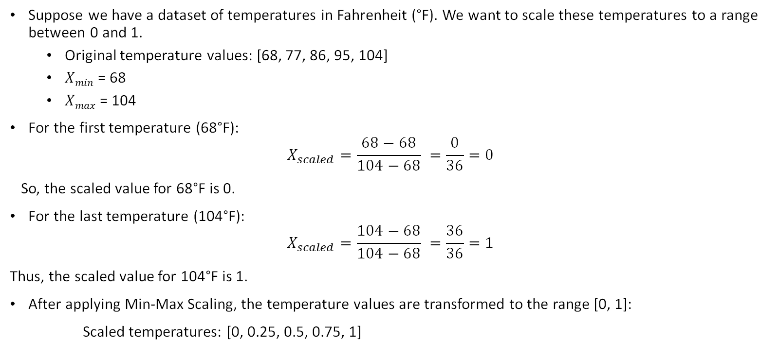
Min-Max Scaling Example
Suppose we have a dataset of temperatures in Fahrenheit (°F). We want to scale these temperatures to a range between 0 and 1.
Original temperature values: [68, 77, 86, 95, 104]
𝑋_{𝑚𝑖𝑛} = 68
𝑋_{𝑚𝑎𝑥} = 104
For the first temperature (68°F):
$$X_{scaled}=\frac{68−68}{104−68} =\frac{0}{36}=0$$
So, the scaled value for 68°F is 0.
For the last temperature (104°F):
$$X_{scaled}=\frac{104−68}{104−68} =\frac{36}{36}=1$$
Thus, the scaled value for 104°F is 1.
After applying Min-Max Scaling, the temperature values are transformed to the range [0, 1]:
Scaled temperatures: [0, 0.25, 0.5, 0.75, 1]

Slide 20
Textual Features
Textual features are used for analyzing and processing text data, such as documents or messages.
Text data can be represented as a vector, where each dimension corresponds to a unique term or word
Example: Bag of Words (BoW)

Slide 21

Bag of Words (BoW)
The Bag of Words (BoW) is a mathematical way to represent text data. In this method, each document or sentence is transformed into a numerical vector.
Each dimension of the vector corresponds to a unique word or term in the entire corpus of documents.
The value in each dimension represents the frequency or presence of that word in the document.
BoW treats text as an unordered set of words, ignoring grammar and word order.
It's a foundational technique in natural language processing (NLP) and text analysis.

Slide 22
Bag of Words (BoW) Example
Small Documents containing two sentences:
Bangladesh will win ICC World Cup 2023
Bangladesh have best battling lineup
Unique Terms:
Bangladesh, will, win, ICC, World, Cup, 2023, have, best, batting, lineup
Representations:
V₁ =
V₂ =
1 | 1 | 1 | 1 | 1 | 1 | 1 | 0 | 0 | 0 | 0
1 | 0 | 0 | 0 | 0 | 0 | 0 | 1 | 1 | 1 | 1

Slide 23
Time-Series Features
Time-series features are used for data that changes over time, such as stock prices, weather data, or sensor readings.
Time-series data is often represented as a sequence of values indexed by time.
Example: Lag Features

Slide 24
Types of Processes
Processes
Feature Creation
Feature Transformation
Feature Extraction
Feature Selection
Feature Scaling

Slide 25
Feature Creation
Feature Creation is the process of generating new features based on domain knowledge or by observing patterns in the data.
It is a form of feature engineering that can significantly improve the performance of a machine-learning model.
Feature creation is finding the most useful variables to be used in a predictive model.
The process is subjective, and it requires human creativity and intervention.
The new features are created by mixing existing features using addition, subtraction, and ration, and these new features have great flexibility.

Slide 26
Types of Feature Creation
Domain-Specific
Creating new features based on domain knowledge, such as creating features based on business rules or industry standards.
Data-Driven
Creating new features by observing patterns in the data, such as calculating aggregations or creating interaction features.
Synthetic
Generating new features by combining existing features or synthesizing new data points.

Slide 27

Domain-Specific Feature Creation
Domain-specific feature creation involves generating new attributes based on domain knowledge. These features are often derived from business rules, industry standards, or subject matter expertise.
Examples: For instance, in the financial industry, domain-specific features might include risk scores or financial ratios based on specific regulations and industry standards.

Slide 28

Data Driven Feature Creation
Data-driven feature creation is the process of generating new attributes by observing patterns and trends within the dataset. These features are directly derived from the data itself.
Examples: Common data-driven features include aggregations like mean, median, or standard deviation of numerical variables. Interaction features, such as the product of two variables, are also data-driven.

Slide 29

Synthetic Feature Creation
Synthetic feature creation involves generating new attributes by combining existing features or creating entirely new data points. This type of feature creation often focuses on generating diverse and complex features."
Examples: Synthetic features can include polynomial features, cross-features, or new data points created through data augmentation or oversampling techniques.

Slide 30
Choosing the Right Approach
Criteria:
Selecting the appropriate approach for feature creation depends on factors like the nature of your data, the problem you're solving, and the available domain knowledge.
Balancing Act:
In practice, a combination of domain-specific, data-driven, and synthetic feature creation can provide the most comprehensive set of features for machine learning models.

Slide 31
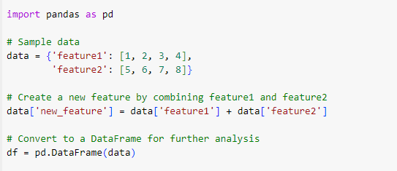
Code Example
Import the pandas library.
Create a dictionary data with two existing features.
Create a new feature, 'new_feature', by adding 'feature1' and 'feature2'.
Create a DataFrame, df, to store the data, including the new feature.

Slide 32
Benefits of Feature Creation:
Improves Model Performance: By providing additional and more relevant information to the model, feature creation can increase the accuracy and precision of the model.
Increases Model Robustness: By adding additional features, the model can become more robust to outliers and other anomalies.
Improves Model Interpretability: By creating new features, it can be easier to understand the model’s predictions.
Increases Model Flexibility: By adding new features, the model can be made more flexible to handle different types of data.

Slide 33
Feature Transformation
Feature Transformation is the process of transforming the features into a more suitable representation for the machine learning model.
This is done to ensure that the model can effectively learn from the data.
The transformation step of feature engineering involves adjusting the predictor variable to improve the accuracy and performance of the model.
For example, it ensures that the model is flexible to take input of the variety of data; it ensures that all the variables are on the same scale, making the model easier to understand.
It improves the model's accuracy and ensures that all the features are within the acceptable range to avoid any computational error.

Slide 34

Types of Feature Transformation
There are several types of feature transformation techniques, each serving a unique purpose.
Normalization
Scaling
Encoding
Transformation

Slide 35
Normalization
Normalization involves rescaling the features to have a similar range, typically between 0 and 1.
This prevents some features from dominating others and ensures fair consideration by the model.
Example: Student A gets 85 out of 100, and Student B gets 95 out of 100. To normalize these grades in a 0-1 range dividing by the maximum possible score (100) gives A=0.85 and B=0.95.

Slide 36
Scaling
Scaling aims to rescale the features to have a similar scale, often with a standard deviation of 1.
This ensures that all features are considered equally and prevents dominance by features with larger ranges.
Example: Changing the range of temperatures from Fahrenheit to Celsius without converting them to a 0-1 scale.

Slide 37
Encoding
Encoding is the process of transforming categorical features into a numerical representation.
It allows machine learning models to work with non-numeric data.
Example: For instance, transforming categories like 'Red,' 'Green,' 'Blue' into binary vectors enables model input and analysis.
Common techniques include one-hot encoding and label encoding.

Slide 38
Transformation
Transformation involves altering the features using mathematical operations to change their distribution or scale.
Examples include logarithmic, square root, and reciprocal transformations
Transformations make distribution of features more suitable for model assumptions or to normalize the data.

Slide 39
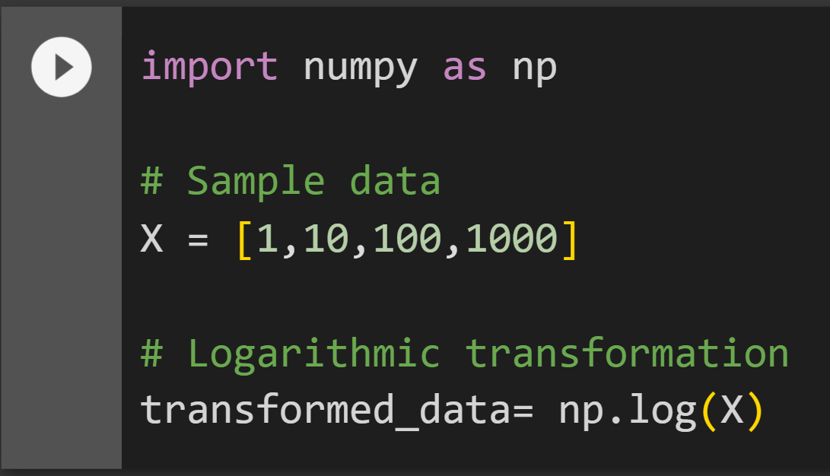
Code Example

Slide 40
Benefits of Feature Transformation
Suitable Features: BF transforming the features into a more suitable representation, the model can learn more meaningful patterns in the data.
Less Computation: The transformed features often require fewer computational resources.
Interopretablility: By transforming the features, it can be easier to understand the model’s predictions.
Handle Outliers: Transforming the features can make the model more robust to outliers and other anomalies.

Slide 41
Feature Extraction
Feature Extraction is the process of creating new features from existing ones to provide more relevant information to the machine learning model.
The main aim of this step is to reduce the volume of data so that it can be easily used and managed for data modelling.
This is done by transforming, combining, or aggregating existing features.
Feature extraction methods include cluster analysis, text analytics, edge detection algorithms, and principal components analysis (PCA).

Slide 42
Types of Feature Extraction
Dimensionality Reduction
Feature Combination
Feature Aggregation
Feature Transformation

Slide 43

Dimensionality Reduction
Reducing the number of features by transforming the data into a lower-dimensional space while retaining important information.
Examples are PCA, LDA and t-SNE.

Slide 44
Principal Component Analysis (PCA)
PCA is a dimensionality reduction technique that transforms original features into principal components.
It identifies principal components by finding the eigenvalues and eigenvectors of the data's covariance matrix.
These principal components capture the directions of maximum data variance.
Valuable for dimensionality reduction while preserving crucial information.
Widely used in image processing to reduce dimensionality and maintain key visual features.
Enables image compression for easier storage and analysis.

Slide 45
Linear Discriminant Analysis (LDA)
LDA is a supervised dimensionality reduction technique that maximizes the separation between classes while minimizing the variance within each class.
LDA involves the computation of scatter matrices. The inter-class scatter matrix and the intra-class scatter matrix are used to find the optimal linear transformation.
LDA is particularly useful in scenarios where the goal is to reduce dimensionality while preserving class separability.
It transforms data into a new space where the classes are well-separated, making it beneficial for classification tasks
LDA is valuable in applications like face recognition. It extracts features that maximize the separation between different individuals' facial characteristics, improving the accuracy of recognition.

Slide 46

t-Distributed Stochastic Neighbor Embedding (t-SNE)
t-SNE is a non-linear dimensionality reduction technique that maps high-dimensional data to a lower-dimensional space while preserving the similarity structure between data points.
t-SNE uses a probabilistic approach to model pairwise similarities between data points.
It aims to minimize the divergence between two probability distributions:
one representing pairwise similarities in the high-dimensional space and
the other in the lower-dimensional space.
Application: Fields like bioinformatics to visualize gene expression data or in natural language processing to visualize word embeddings.

Slide 47
Feature Combination
Combining two or more existing features to create a new one.
For example, the interaction between two features. For instance, combining 'Hours Worked' and 'Hourly Wage' into 'Earnings' shows their relationship.
Improves model understanding of complex data patterns.
Domain knowledge is crucial for meaningful combinations.

Slide 48
Feature Aggregation
Feature aggregation involves creating new features by summarizing or aggregating sets of existing features. Common methods include calculating means, sums, or counts.
For instance, in a dataset with daily sales, aggregating 'Sales' by calculating the monthly 'Total Sales' summarizes the daily data into a higher-level feature.
Simplifies data, reduces dimensionality, and provides insights into broader trends and patterns.
Widely used in time-series data, financial analysis, and data with multiple measurements over time.

Slide 49
Feature Transformation
Feature transformation is the process of converting existing features into a new representation. This can involve mathematical operations like log transformations to address skewed data distributions.
In financial data, applying a log transformation to 'Price' can normalize the distribution, making it suitable for modeling.
Enhances data quality, improves model performance, and resolves issues with non-linear relationships.
Commonly used in data preprocessing to prepare data for machine learning algorithms.

Slide 50
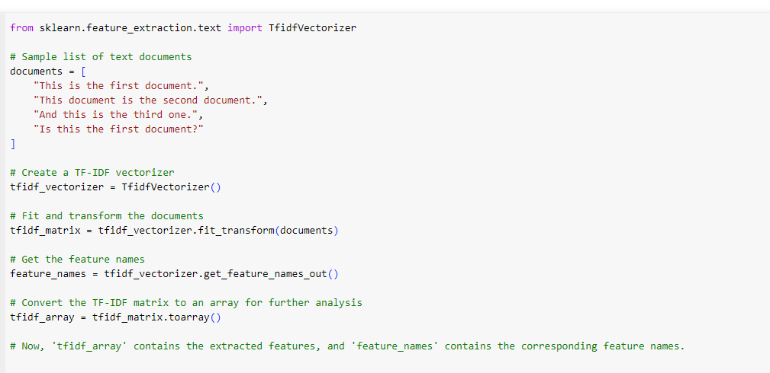
Feature Extraction Code Example

Slide 51
Benefits of Feature Extraction
Improves Model Performance: By creating new and more relevant features, the model can learn more meaningful patterns in the data.
Reduces Overfitting: By reducing the dimensionality of the data, the model is less likely to overfit the training data.
Improves Computational Efficiency: The transformed features often require fewer computational resources.
Improves Model Interpretability: By creating new features, it can be easier to understand the model’s predictions.

Slide 52
Feature Selection
Feature selection is the process of choosing the most important and relevant features (characteristics) from your data to use in a machine learning model, while discarding less useful or redundant ones. It helps improve model performance and reduces complexity.
While developing the machine learning model, only a few variables in the dataset are useful for building the model, and the rest features are either redundant or irrelevant.
If we input the dataset with all these redundant and irrelevant features, it may negatively impact and reduce the overall performance and accuracy of the model. Hence it is very important to identify and select the most appropriate features from the data and remove the irrelevant or less important features, which is done with the help of feature selection in machine learning

Slide 53
Types of Feature Selection
Filter Method
Wrapper Method
Embedded Method

Slide 54
Filter Methods
Filter methods are a category of feature selection techniques that evaluate individual features independently, without considering interactions between features.
They aim to identify the most relevant features based on specific mathematical criteria.
Filter methods use various mathematical criteria to assess the relevance of each feature to the target variable. Common criteria include:
Chi-squared test: Measures the statistical independence between features and the target.
Mutual information: Quantifies the information shared between features and the target.
ANOVA F-statistic: Assesses differences in feature means across target categories.
Correlation coefficient: Measures the linear relationship between numerical features and the target.

Slide 55

Filter Methods
Advantages:
Efficiency: Filter methods are computationally efficient, making them suitable for high-dimensional datasets.
Independence: They do not require a specific learning algorithm and can be applied before model selection.
Interpretability: The selected features are often easy to interpret.
Limitations:
Feature Independence: Filter methods do not account for feature interactions, potentially missing important relationships between features.
Over-Selection: They may select many features, including irrelevant ones, leading to overfitting if not combined with model evaluation.
Use Cases:
Filter methods are commonly used in text classification, image processing, and initial feature screening.

Slide 56
Wrapper Methods
Wrapper methods are a class of feature selection techniques that incorporate the machine learning model's performance during the feature selection process.
They iteratively evaluate different subsets of features by training and testing models.

Slide 57
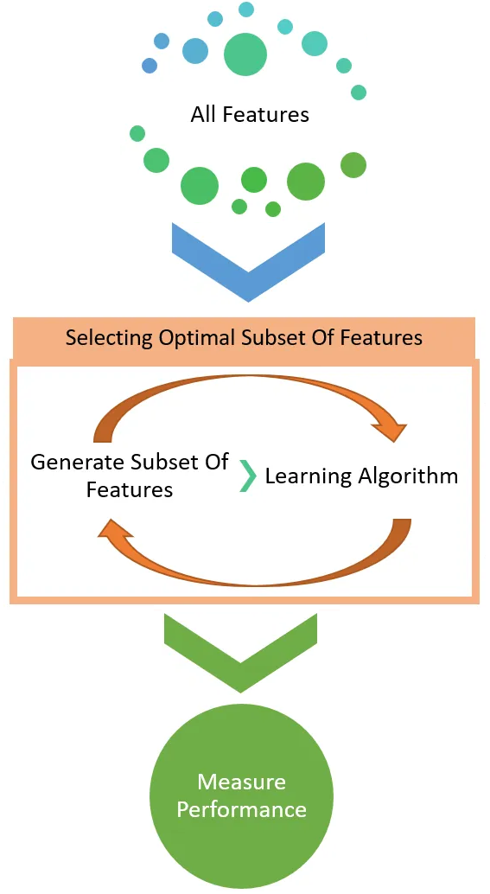
Wrapper Methods
Wrapper methods use search strategies to determine the optimal feature subset, including:
Forward Selection:
Starts with an empty set of features and adds them one by one, evaluating model performance at each step.
The process typically starts with a feature that has the strongest individual predictive power.
It assesses how adding this feature improves model performance.
If performance improves, the feature is retained, and the search continues by adding another feature.

Slide 58
Wrapper Methods
Backward Elimination:
It initiates with all available features
Iteratively removes one feature at a time.
Model performance is evaluated after each feature removal.
Assesses the impact of removing each feature on model performance.
The feature that, when removed, least affects model performance is dropped in each iteration.

Slide 59
Wrapper Methods
Advantages:
Feature Interactions: Wrapper methods can consider feature interactions, capturing complex relationships between features.
Model-Dependent: They are model-dependent and select features that directly impact the chosen learning algorithm's performance.
Limitations:
Computational Intensity: Wrapper methods can be computationally expensive, especially with large feature spaces, due to multiple model evaluations.
Potential Overfitting: They are prone to overfitting if not cross-validated properly.
Use Cases:
Wrapper methods find applications in scenarios where feature interactions are crucial, such as image recognition.

Slide 60

Embedded Methods
Embedded methods are a class of feature selection techniques that integrate feature selection during the model-building process.
Embedded methods often rely on regularization techniques. These techniques introduce a penalty term into the model's cost function to control the importance of individual features. Common regularization techniques include:
L1 Regularization (Lasso): Encourages sparsity by adding the absolute values of feature coefficients to the cost function.
L2 Regularization (Ridge): Adds the squared values of feature coefficients to the cost function, encouraging a smoother solution.

Slide 61
Embedded Methods
Advantages
Feature Importance:
Embedded methods explicitly evaluate feature importance, resulting in a feature subset that directly impacts model performance.
Automatic Feature Selection:
Features are selected during model training, reducing the need for a separate feature selection step.
Limitations
Model Dependency:
The choice of the machine learning model and the regularization parameter can affect the selected feature subset.
Computational Complexity:
Training models with embedded feature selection can be computationally intensive.
Use Cases
Embedded methods are commonly used in predictive modeling tasks such as regression and classification. They are valuable when feature importance and model interpretability are essential.

Slide 62
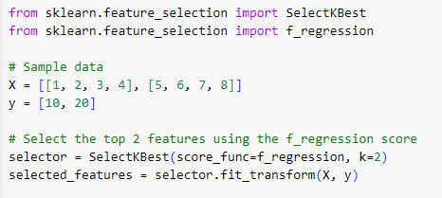
Code Example

Slide 63
Benefits of Feature Selection:
Reduces Overfitting: By using only the most relevant features, the model can generalize better to new data.
Improves Model Performance: Selecting the right features can improve the accuracy, precision, and recall of the model.
Decreases Computational Costs: A smaller number of features requires less computation and storage resources.
Improves Interpretability: By reducing the number of features, it is easier to understand and interpret the results of the model.

Slide 64
Feature Scaling
Feature Scaling is the process of transforming the features so that they have a similar scale.
This is important in machine learning because the scale of the features can affect the performance of the model.
Types of Feature Scaling:
Min-Max Scaling: Rescaling the features to a specific range, such as between 0 and 1, by subtracting the minimum value and dividing by the range.
Standard Scaling: Rescaling the features to have a mean of 0 and a standard deviation of 1 by subtracting the mean and dividing by the standard deviation. This is achieved by subtracting the mean from each feature and then dividing by the standard deviation.
Robust Scaling: Rescaling the features to be robust to outliers by dividing them by the interquartile range.

Slide 65
Code Example
Suppose, a dataset with two features, age and height. The age feature ranges from 20 to 65 years old, and the height feature ranges from 1.6 to 1.8 meters. To min-max scale these features, we would first subtract the minimum value from each feature:
age_scaled = age - 20
height_scaled = height - 1.6
Next, we would divide each feature by the range:
age_scaled = age_scaled / 45 height_scaled = height_scaled / 0.2
This would give us two new features, age_scaled and height_scaled, which are both on a scale of 0 to 1.

Slide 66
Code Example
we have the same dataset as before, with the age and height features. To standard scale these features, we would first calculate the mean and standard deviation of each feature:
age_mean = np.mean(age) age_std = np.std(age) height_mean = np.mean(height) height_std = np.std(height)
Next, we would subtract the mean from each feature and then divide by the standard deviation:
age_scaled = (age - age_mean) / age_std height_scaled = (height - height_mean) / height_std
To robust scale these features, we would first calculate the IQR of each feature:
age_iqr = np.percentile(age, 75) - np.percentile(age, 25) height_iqr = np.percentile(height, 75) - np.percentile(height, 25)
Next, we would divide each feature by the IQR:
age_scaled = age / age_iqr height_scaled = height / height_iqr

Slide 67
Steps in Feature Engineering
1. Data Cleansing
2. Data Transformation
3. Feature Extraction
4. Feature Selection
5. Feature Iteration
6. Feature Split

Slide 68

Data Cleansing
Data cleansing, also known as data cleaning or data scrubbing, is a crucial step in the data preparation process.
It involves identifying and addressing errors, inconsistencies, and inaccuracies in the dataset to ensure data quality and reliability.
Data quality is paramount for accurate and trustworthy analyses and modeling.
Clean data helps in making informed decisions, minimizing errors, and improving the overall integrity of the dataset.
Common Data Quality Issues:
Missing values
Duplicate records
Inaccurate or inconsistent entries
Outliers and anomalies
Format and type discrepancies

Slide 69
Data Cleansing
Data Cleansing Methods:
Imputation for missing values
Deduplication for duplicate records
Outlier detection and handling
Standardization and format validation
Data type conversion
Process:
Data cleansing typically involves a systematic process of inspection, correction, and validation, often using automated tools and manual review to ensure data accuracy.

Slide 70
Data Cleansing
Benefits:
Accurate Analysis: Clean data enhances the accuracy of analytical models and decision-making.
Reduced Errors: Minimizing errors and inconsistencies reduces the risk of misinformation.
Improved Data Integrity: High-quality data is essential for maintaining trust in data-driven applications.
Challenges:
Data cleansing can be time-consuming, especially with large datasets. It may require domain knowledge for effective correction.

Slide 71
Feature Iteration
Feature iteration is the process of iteratively improving the features used to train a machine learning model.
This iterative process includes the addition of new features, removal of redundant ones, and experimenting with various feature transformations.
Effective feature iteration can lead to significant improvements in the accuracy and performance of machine learning models by continually optimizing the set of features used for training.
Key Aspects of Feature Iteration:
Adding New Features: Incorporating new features that provide relevant information or insights can enhance the model's predictive power.
Feature Removal: Identifying and removing redundant or irrelevant features can simplify the model and reduce noise.
Feature Transformation: Experimenting with different feature transformations, such as scaling or encoding, can improve model fit and interpretability."

Slide 72
Feature Iteration
Goals of Feature Iteration:
Optimizing Model Performance: The primary goal is to improve the model's accuracy and predictive capability.
Reducing Overfitting: Careful iteration can help reduce the risk of overfitting by fine-tuning the feature set.
Enhancing Model Interpretability: Effective iteration can lead to features that are more interpretable and meaningful.
When to Iterate:
Feature iteration should be an ongoing process, especially when dealing with complex models or evolving datasets. It's valuable after initial model testing and whenever new data is available.
Example:
In a predictive model for customer churn, feature iteration may involve adding new features such as customer interaction history, refining existing features related to customer behavior, and removing redundant variables that don't contribute to the model's predictive power.
Challenges:
Balancing the trade-off between model complexity and performance is a key challenge in feature iteration. It requires careful evaluation and validation of changes.

Slide 73
Feature Split
Feature split is a critical aspect of feature engineering that involves dividing a single variable into multiple variables to extract and analyze separate pieces of information.
This process is particularly useful when a feature contains multiple facets of data that can be more effectively examined individually.
Feature split allows for a more detailed and comprehensive analysis of data by isolating specific elements within a single variable. This not only enhances data understanding but also boosts the performance of machine learning models."
Key Aspects of Feature Split:
Variable Decomposition: Feature split decomposes a single variable into multiple sub-variables or 'sub-features.'
Information Extraction: It helps extract valuable information that might be hidden in a composite feature.
Improved Model Performance: By providing additional insights, feature split can lead to enhanced model accuracy and predictive power."

Slide 74
Feature Split
Common Use Cases:
Date Split: Breaking down a date feature into year, month, and day components.
Address Split: Separating an address feature into street, city, state, and postal code components.
Name Split: Splitting a full name feature into first name and last name components."
Example:
In a customer dataset, a 'Location' feature, which contains the complete address, can be split into 'City,' 'State,' and 'Postal Code' features.
This allows for precise geographical analysis and targeted marketing efforts.
Benefits:
Enhanced Data Analysis: Feature split provides a granular view of the data, making it easier to detect patterns and relationships.
Improved Model Understanding: It simplifies model interpretation by presenting variables with distinct meanings.
Higher Predictive Accuracy: By capturing more detailed information, machine learning models can make better predictions.
Challenges:
Determine the appropriate splits and ensure that sub-features maintain their individual relevance while collectively improving the dataset.

Slide 75

Feature Engineering Techniques
Imputation
Handling Outliers
Log Transformation
Binning
Text Data Preprocessing
One Hot Encoding

Slide 76
Handling Missing Data
Missing data refers to the absence of values in a dataset where information should ideally be present.
Handling missing data is a crucial aspect of data preprocessing in feature engineering.
Effective handling of missing data is vital for maintaining data quality and ensuring accurate model building and analysis.
Challenges of Missing Data:
Reduced Sample Size: Missing data leads to a reduction in the available data for analysis.
Biased Results: If the missing data is not handled properly, it can lead to biased or inaccurate results.
Misrepresentation: The presence of missing values may misrepresent relationships within the data."

Slide 77
Handling Missing Data
Strategies for Handling Missing Data:
Imputation: Filling in missing values using various techniques.
Exclusion: Removing observations or features with missing data.
Model-Based Imputation: Leveraging machine learning models to predict missing values.

Slide 78
Imputation
Imputation is the process of replacing missing data with estimated or calculated values.
This step is essential in data preprocessing to ensure that missing values do not hinder the analysis and modeling processes.
Some of the techniques are:
Mean Imputation
Median Imputation
Regression Imputation
K-Nearest Neighbors Imputation

Slide 79
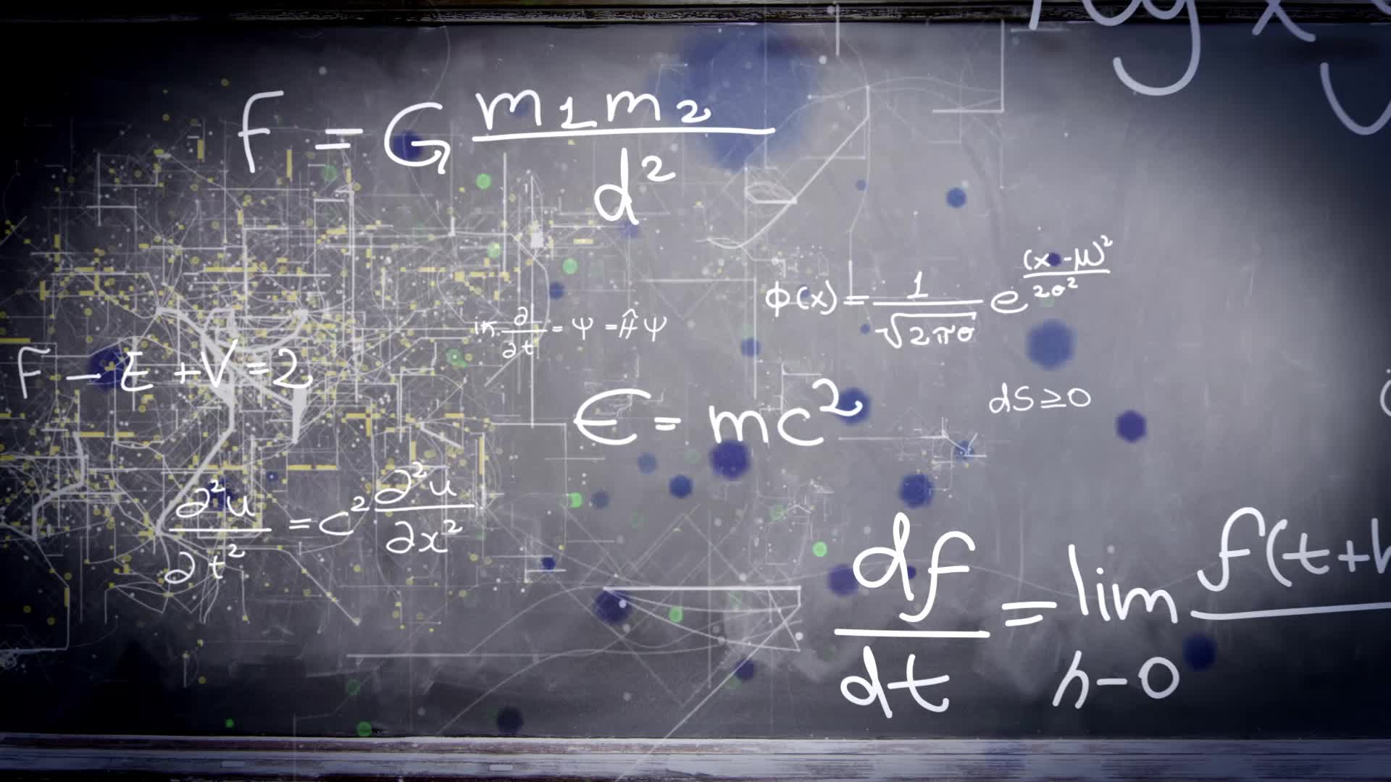
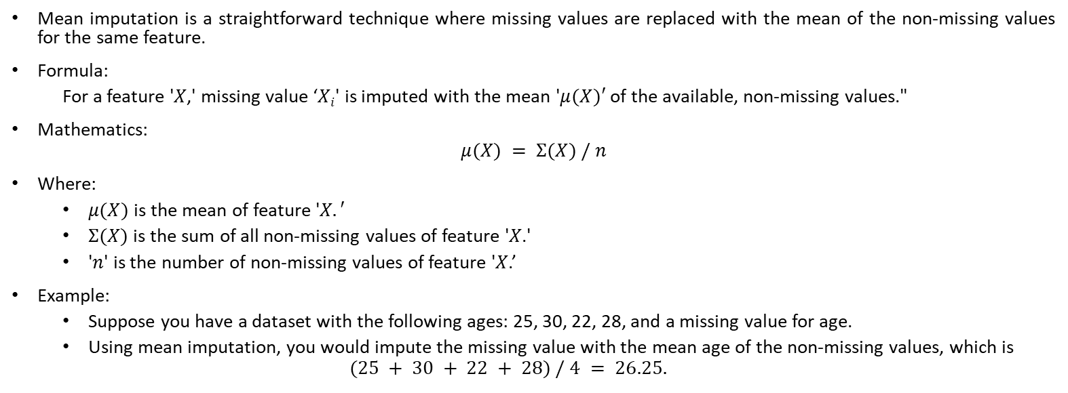
Mean Imputation
Mean imputation is a straightforward technique where missing values are replaced with the mean of the non-missing values for the same feature.
Formula:
For a feature '$X$,' missing value ‘$Xi$' is imputed with the mean '$μ(X)′$of the available, non-missing values."
Mathematics:
$$μ(X) = Σ(X) / n$$
Where:
$μ(X)$is the mean of feature '$X.′$
$Σ(X)$is the sum of all non-missing values of feature '$X$.'
'$n$' is the number of non-missing values of feature '$X$.’
Example:
Suppose you have a dataset with the following ages: 25, 30, 22, 28, and a missing value for age.
Using mean imputation, you would impute the missing value with the mean age of the non-missing values, which is
$$(25 + 30 + 22 + 28) / 4 = 26.25.$$

Slide 80
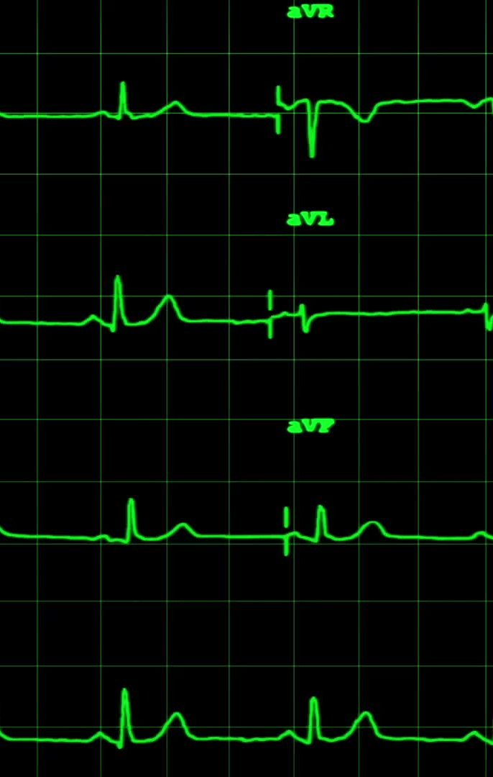
Median Imputation
Median imputation replaces missing values with the median of the non-missing values within the same feature.
Formula:
For a feature 'X,' missing value 'X' is imputed with the median 'Med(X)' of the available, non-missing values."
Mathematics:
Med (X) = Median of non – missing values of feature 'X.'
Example:
Suppose dataset with the following ages: 25, 30, 22, 28, and a missing value for age. Using median imputation, you would impute the missing value with the median age of the non-missing values, which is 26.5 (the middle value when sorted).

Slide 81

Regression Imputation
Regression imputation is a more advanced technique that utilizes regression models to predict missing values based on other variables in the dataset.
Regression imputation typically involves creating a predictive model, often linear regression, where the missing variable is treated as the dependent variable, and the other relevant features are used as predictors.
Process:
Model Selection: Choose a regression model that suits your data and problem (e.g., linear regression, decision trees).
Feature Selection: Identify relevant features to predict the missing value.
Training the Model: Use available data points to train the regression model.
Prediction: Apply the trained model to predict and impute missing values.

Slide 82
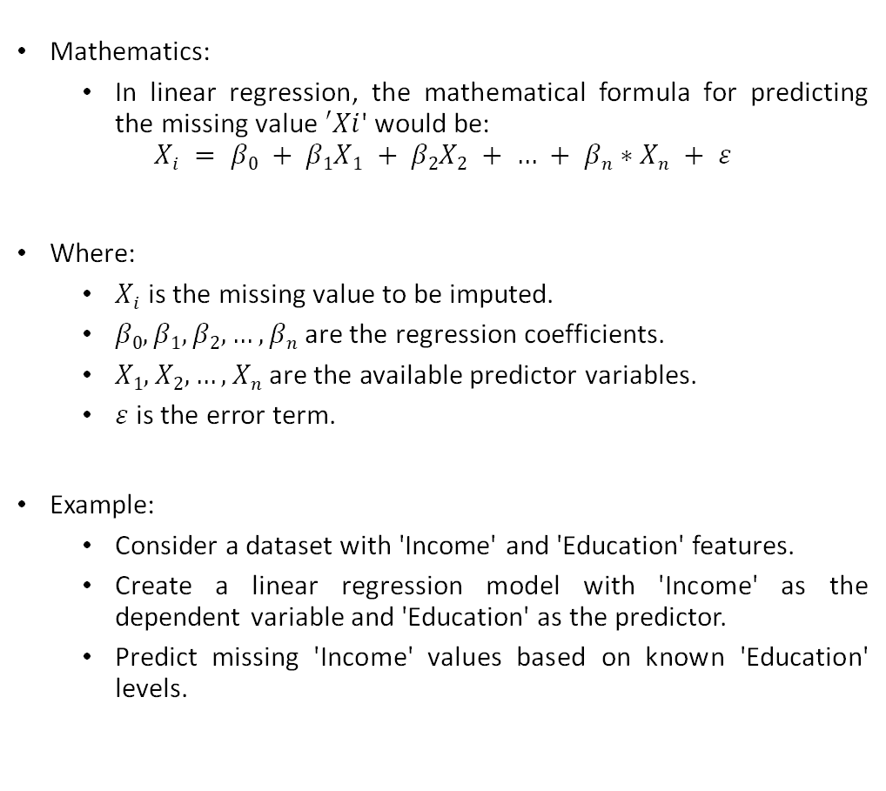
Regression Imputation
Mathematics:
In linear regression, the mathematical formula for predicting the missing value $′Xi$' would be:
$$Xi = β0 + β1X1 + β2X2 + … + βn∗Xn + ε$$
Where:
$Xi$ is the missing value to be imputed.
$β0, β1, β2, …, βn$are the regression coefficients.
$X1, X2, …, Xn$are the available predictor variables.
$ε$ is the error term.
Example:
Consider a dataset with 'Income' and 'Education' features.
Create a linear regression model with 'Income' as the dependent variable and 'Education' as the predictor.
Predict missing 'Income' values based on known 'Education' levels.

Slide 83
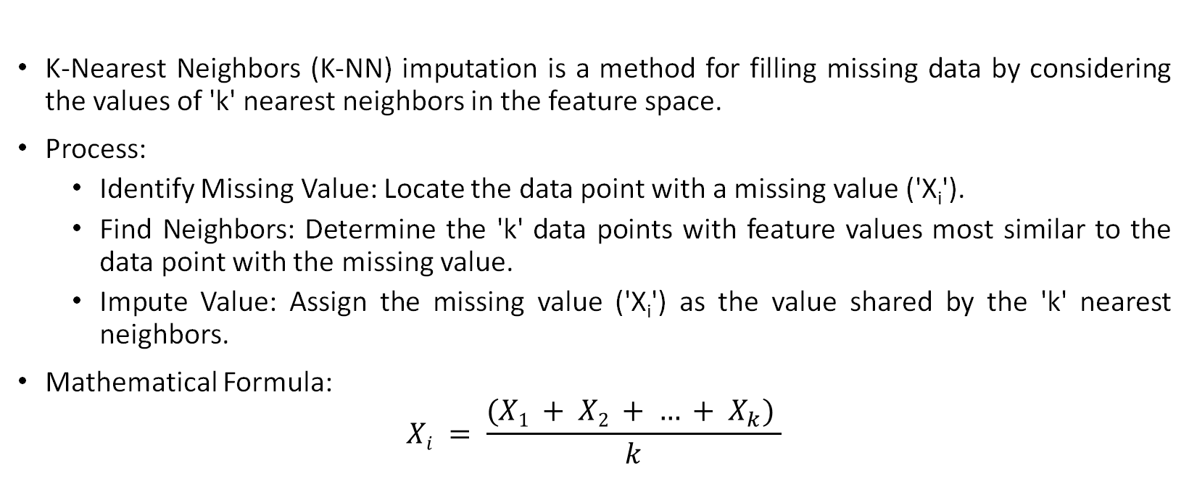
K-Nearest Neighbors Imputation
K-Nearest Neighbors (K-NN) imputation is a method for filling missing data by considering the values of 'k' nearest neighbors in the feature space.
Process:
Identify Missing Value: Locate the data point with a missing value ('X_{i}').
Find Neighbors: Determine the 'k' data points with feature values most similar to the data point with the missing value.
Impute Value: Assign the missing value ('X_{i}') as the value shared by the 'k' nearest neighbors.
Mathematical Formula:
$$Xi = \frac{(X1 + X2 + … + X_{k}) }{k}$$

Slide 84
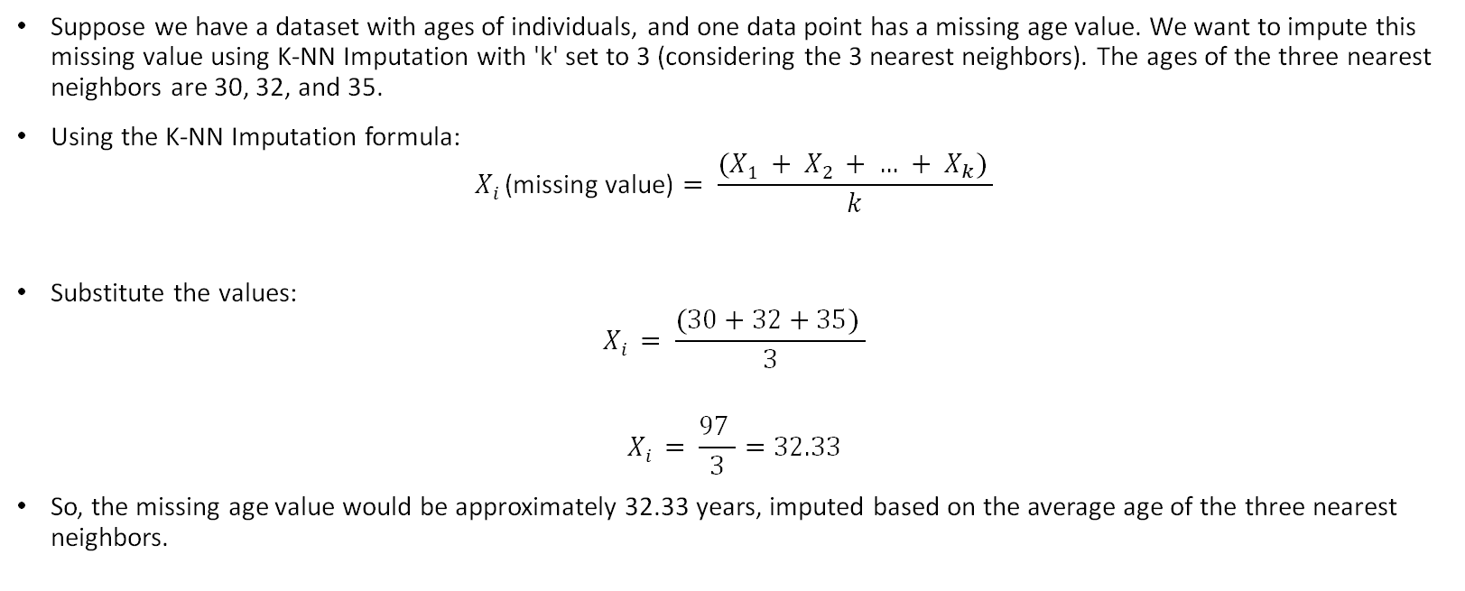
Example
Suppose we have a dataset with ages of individuals, and one data point has a missing age value. We want to impute this missing value using K-NN Imputation with 'k' set to 3 (considering the 3 nearest neighbors). The ages of the three nearest neighbors are 30, 32, and 35.
Using the K-NN Imputation formula:
$$Xi \text{(}\text{missing} \text{value}\text{)}= \frac{(X1 + X2 + … + X_{k}) }{k}$$
Substitute the values:
$$Xi = \frac{(30+32+35) }{3}$$
$$Xi = \frac{97 }{3}=32.33$$
So, the missing age value would be approximately 32.33 years, imputed based on the average age of the three nearest neighbors.

Slide 85
Handling Outliers
Outliers are data points that significantly deviate from majority of the data, potentially affecting model performance.
This feature engineering technique involves identifying and managing outliers to improve data quality and model accuracy.
Identifying Outliers:
Standard Deviation Method:
Outliers can be detected by calculating the standard deviation of the data.
Data points that are several standard deviations away from the mean are considered outliers.
For instance, data points beyond, say, 2 or 3 standard deviations from the mean may be classified as outliers.
Z-Score Method:
Z-scores measure how many standard deviations a data point is from the mean.
Data points with high Z-scores may be considered outliers.
A common threshold for identifying outliers using Z-scores is a Z-score greater than 2 or 3.

Slide 86
Handling Outliers
Removal:
One approach to handling outliers is to remove them from the dataset.
However, this should be done cautiously, as removing too many outliers can result in a loss of valuable information.
Transformation:
Transforming data using mathematical techniques, such as logarithmic or square root transformations, can reduce the impact of outliers.
Winsorization:
Winsorization involves capping the extreme values by replacing them with the nearest non-extreme values within a specified range.
Robust Scaling:
Robust scaling methods, like the Median Absolute Deviation (MAD), are less sensitive to outliers and can be used to scale data.

Slide 87
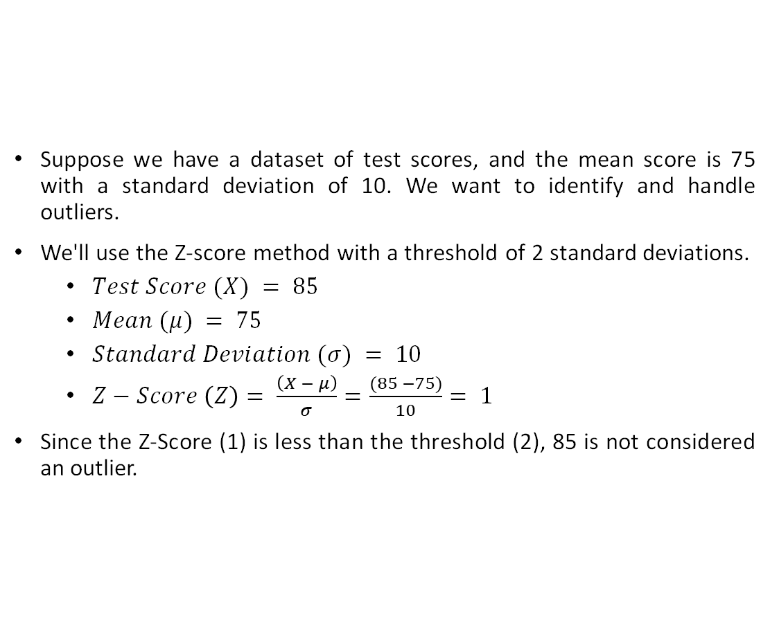
Example
Suppose we have a dataset of test scores, and the mean score is 75 with a standard deviation of 10. We want to identify and handle outliers.
We'll use the Z-score method with a threshold of 2 standard deviations.
$Test Score (X) = 85$
$Mean (μ) = 75$
$Standard Deviation (σ) = 10$
$Z−Score \left(Z\right)= \frac{\left(X − μ\right)}{σ}=\frac{(85 −75)}{10}= 1$
Since the Z-Score (1) is less than the threshold (2), 85 is not considered an outlier.

Slide 88
Log Transformation
Logarithm transformation, often referred to as log transform, is a commonly used mathematical technique in feature engineering and machine learning.
It aims to address several data challenges and improve the quality of the data for modeling.
Key Objectives:
Handling Skewed Data:
Log transform is effective in handling data with a skewed distribution, such as right-skewed (positively skewed) data.
It can make the data distribution more symmetric and closer to a normal distribution.
Reducing the Impact of Outliers:
Log transform helps mitigate the effects of outliers on the data.
By normalizing the magnitude differences, the model becomes more robust and less sensitive to extreme values.

Slide 89
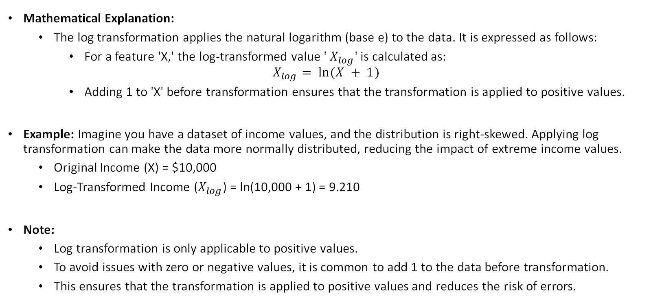
Log Transformation
Mathematical Explanation:
The log transformation applies the natural logarithm (base e) to the data. It is expressed as follows:
For a feature 'X,' the log-transformed value ' $X_{log}$' is calculated as:
$$X_{log}⁡= ln⁡(X + 1)$$
Adding 1 to 'X' before transformation ensures that the transformation is applied to positive values.
Example: Imagine you have a dataset of income values, and the distribution is right-skewed. Applying log transformation can make the data more normally distributed, reducing the impact of extreme income values.
Original Income (X) = $10,000
Log-Transformed Income ($X_{log}$) = ln(10,000 + 1) = 9.210
Note:
Log transformation is only applicable to positive values.
To avoid issues with zero or negative values, it is common to add 1 to the data before transformation.
This ensures that the transformation is applied to positive values and reduces the risk of errors.

Slide 90
Binning
Binning is a valuable feature engineering technique used in machine learning to address the issues of overfitting and noisy data.
It involves segmenting different features into bins or intervals, effectively grouping data points based on their values.
Key Objectives:
Noise Reduction:
Binning helps in reducing the noise in data by grouping similar data points into bins.
This can make the data more robust and less sensitive to small variations.
Handling Continuous Data:
Binning is particularly useful for handling continuous data, transforming it into categorical or discrete form.
It simplifies the data while retaining its important characteristics.

Slide 91
Binning
Process:
Dividing Data into Bins:
Data points are divided into multiple bins, where each bin represents a specific range or interval of values.
Assigning Data Points:
Each data point is then assigned to the appropriate bin based on its value within the feature.
Categorical Representation:
The data points are represented in a categorical or discrete format, making it easier to analyze and model.
Example:
Consider a dataset of customer ages. To address overfitting and noise, the ages can be binned into categories:
Young (0-18 years)
Adult (19-64 years)
Senior (65+ years)
This is often done based on the feature's statistical properties or domain knowledge.

Slide 92
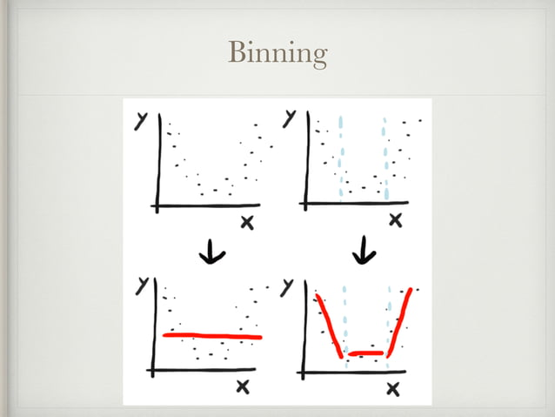
Binning

Slide 93
Binning
Benefits:
Binning reduces the complexity of the data, making it easier to model.
It can improve model generalization by grouping similar data points.
Binned features can be used for descriptive statistics, analysis, and modeling.
Challenges:
Choosing the right bin sizes and boundaries is crucial and may require domain knowledge.
Binning can lead to information loss, so it should be used judiciously.

Slide 94
Feature Engineering with Text Data
In Natural Language Processing, any text-based problem needs to be converted into a form that can be modeled. These are some of the techniques to do so
Bag of Words (BoW)
TF-IDF (Term Frequency-Inverse Document Frequency)
Word Embeddings (e.g., Word2Vec)

Slide 95

TF-IDF (Term Frequency-Inverse Document Frequency)
TF-IDF (Term Frequency-Inverse Document Frequency) is a text feature engineering technique that quantifies the importance of a term within a document relative to its importance across the entire corpus.
It is widely used in natural language processing and text analysis.
Mathematical Formula:
TF (Term Frequency): The frequency of a term (word) within a document.
IDF (Inverse Document Frequency): A measure of how unique or important a term is across the entire corpus.

Slide 96
TF-IDF (Term Frequency-Inverse Document Frequency)
TF (Term Frequency):
Term Frequency is a measure of how frequently a term appears within a document.
It is calculated as the number of times a term 't' appears in a document 'd' divided by the total number of terms in that document.
Mathematically, TF(t, d) = (Number of times term 't' appears in document 'd') / (Total number of terms in document 'd').
IDF (Inverse Document Frequency):
Inverse Document Frequency measures the importance of a term across the entire corpus.
It is calculated as the logarithm of the ratio of the total number of documents in the corpus to the number of documents containing the term 't'.
Mathematically, IDF(t) = log_e(Total number of documents in the corpus / Number of documents containing term 't').

Slide 97
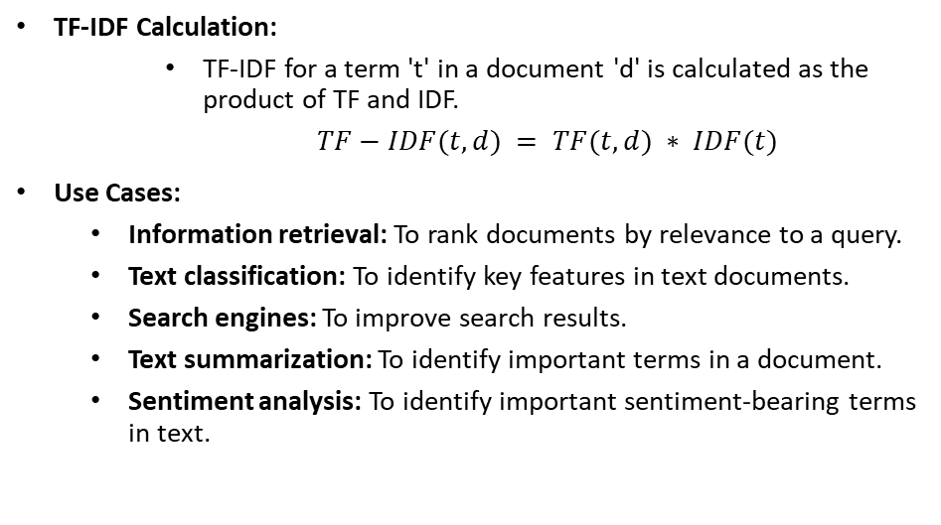
TF-IDF (Term Frequency-Inverse Document Frequency)
TF-IDF Calculation:
TF-IDF for a term 't' in a document 'd' is calculated as the product of TF and IDF.
$TF−IDF(t, d) = TF(t, d) ∗ IDF(t)$
Use Cases:
Information retrieval: To rank documents by relevance to a query.
Text classification: To identify key features in text documents.
Search engines: To improve search results.
Text summarization: To identify important terms in a document.
Sentiment analysis: To identify important sentiment-bearing terms in text.

Slide 98
Word2Vec
Word embeddings are a fundamental technique in natural language processing (NLP) and feature engineering.
They capture the logical meaning of words and represent them as continuous vector spaces.
Word2Vec is a popular word embedding technique developed by Google.
It learns vector representations for words based on their contextual usage in a large corpus of text.
Mathematical Concept:
Word2Vec employs a shallow neural network to learn word embeddings.
The key idea is to predict a target word based on its surrounding context (Continuous Bag of Words - CBOW) or predict context words given a target word (Skip-gram).
The network's hidden layer represents the word embeddings.

Slide 99
Word2Vec
Training Process:
Word2Vec iterates through the entire text corpus, updating word vectors to minimize the prediction error.
The model uses techniques like negative sampling or hierarchical softmax to improve efficiency and training time.
Use Cases:
Word embeddings are used in various NLP tasks, including text classification, sentiment analysis, machine translation, and information retrieval.

Slide 100
Feature Engineering with Time Series Data
Lag Features:
They involve creating new features by shifting the values of the original time-series data in time.
Lag features help capture temporal dependencies and trends in time-series data.
They are used in forecasting, anomaly detection, and predictive modeling for applications like finance, weather, and sales
Rolling Statistics:
Rolling statistics involve calculating summary statistics for a rolling window of data points in a time-series.
Rolling statistics help smooth out noise and highlight trends or patterns in time-series data.
They are used in financial analysis, signal processing, and sensor data analysis.

Slide 101
Feature Engineering with Time Series Data
Time Based Features:
Time-based features capture temporal information within time-series data.
Time-based features can be used for understanding and forecasting temporal patterns, such as daily, weekly, or seasonal variations.
Seasonal Decomposition:
Seasonal decomposition is a technique used to separate time-series data into its constituent components: trend, seasonality, and noise.
It helps identify the underlying patterns and variations in time-series data.
It is valuable for understanding seasonality and making forecasts.
Fourier Transform:
Fourier transform is used in signal processing, image analysis, and time-series analysis.
It helps identify periodicity and frequency patterns in data.

Slide 102

Feature Engineering Algorithms
Feature engineering algorithms are techniques used to create, modify, or select features to improve the performance of machine learning models.
These algorithms play a crucial role in shaping the input data for better model accuracy and efficiency.

Slide 103
Feature Engineering Algorithms
Decision Trees:
Decision trees can be used to select the most informative features based on their ability to split the data effectively.
Mathematical aspects involve assessing feature importance through measures like Gini impurity or information gain.
Random Forest:
Random Forest, an ensemble method of decision trees, extends feature selection by aggregating multiple decision trees.
It provides feature importance scores based on how well features are used to split nodes.
Lasso Regression:
Lasso Regression includes feature selection to enhance the prediction accuracy.
It adds a penalty term to the loss function, encouraging the model to use fewer features.
Principal Component Analysis (PCA):
PCA is used for feature extraction rather than selection. It transforms the original features into a new set of uncorrelated features (principal components).
Linear Discriminant Analysis (LDA):
LDA is a dimensionality reduction technique that maximizes class separability, making it relevant for feature engineering in classification tasks.
XGBoost (Extreme Gradient Boosting):
XGBoost is a gradient boosting algorithm that extends decision trees with feature selection.
It calculates feature importance using gradient boosting techniques and the reduction in the loss function.

Slide 104
XGBoost
XGBoost is an efficient and scalable machine learning algorithm known for its high performance in various data science competitions and real-world applications.

Slide 105
XGBoost
Boosting Algorithm:
XGBoost belongs to the boosting family of algorithms.
It combines the predictions of multiple weak learners (usually decision trees) to create a strong ensemble model.
Gradient Boosting:
XGBoost employs gradient boosting techniques.
It optimizes the model's loss function by minimizing the gradient.
Regularization:
XGBoost includes L1 and L2 regularization terms in the objective function.
This helps prevent overfitting and improves model generalization.
Parallel and Distributed Computing:
XGBoost is designed for parallel and distributed computing.
It can take full advantage of multi-core processors and distributed computing environments.
Tree Pruning:
XGBoost uses tree pruning techniques.
Trees are pruned when they don't contribute significantly to model improvement, resulting in a more efficient model.

Slide 106
XGBoost
Performance Benefits:
XGBoost is known for its exceptional performance in various domains, including classification, regression, ranking, and more.
It has consistently achieved top positions in machine learning competitions on platforms like Kaggle.
Use Cases:
XGBoost is widely used in applications such as fraud detection, recommendation systems, image classification, and more.
Its speed, accuracy, and ability to handle large datasets make it a popular choice.
Integration:
XGBoost can be easily integrated with popular machine learning libraries like scikit-learn and tools like H2O.ai.

Slide 107
Feature Engineering Tools
Feature engineering is a crucial step in data preprocessing, and there are several tools available to streamline the process.
These tools provide automation and support for generating, selecting, and transforming features efficiently. They are:
Featuretools
TPOT (Tree-based Pipeline Optimization Tool)
DataRobot
Alteryx
H2O.ai

Slide 108
Featuretools
A Python library for automatic feature engineering on structured data.
Key Features:
Automated feature engineering using ML algorithms.
Handles time-dependent data.
Integrates with pandas and scikit-learn.
Offers visualization tools and extensive documentation.

Slide 109

TPOT (Tree-based Pipeline Optimization Tool):
An automated machine learning tool that includes feature engineering.
Key Features:
Automatic feature selection and transformation.
Supports various ML models.
Manages missing data and categorical variables.
Integrates with scikit-learn and pandas.

Slide 110

DataRobot
A machine learning automation platform with feature engineering capabilities.
Key Features:
Automatic feature engineering using ML algorithms.
Supports time-dependent and text data.
Integrates with pandas and scikit-learn.
Offers interactive visualization and collaboration tools.

Slide 111
Alteryx
A data preparation and automation tool with feature engineering capabilities.
Key Features:
Supports structured and unstructured data.
Integrates with data sources like Excel and databases.
Provides pre-built feature extraction and transformation tools.
Supports custom scripting and code integration.

Slide 112
H2O.ai
An open-source ML platform with feature engineering capabilities.
Key Features:
Offers automatic and manual feature engineering options.
Supports structured and unstructured data, including text and images.
Integrates with various data sources.
Provides interactive visualization and collaboration tools.

Slide 113
Feature Engineering Best Practices - Domain Knowledge and Mathematical Understanding
Key Concepts:
Domain Knowledge:
Collaborate with experts to grasp mathematical relationships in the domain.
Use mathematical insights to create contextually relevant features.
Mathematical Understanding:
Apply mathematical metrics for feature selection, transformation, and quality assessment.
Use mathematical criteria to rank features based on importance.
Cross-Validation:
Mathematically evaluate feature stability and generalization through cross-validation techniques.
Best Practices:
Combine domain knowledge and mathematical understanding to create relevant and reliable features.
Employ mathematical metrics to assess feature quality, select the most informative features, and ensure generalization through cross-validation.

Slide 114
Feature Engineering Best Practices - Data Preprocessing, Selection, and Interpretability
Key Concepts:
Data Preprocessing:
Apply mathematical techniques for data cleaning, imputation, and transformation.
Address missing data and outliers using mathematical methods.
Feature Selection:
Mathematically evaluate and select features based on relevance and dimensionality reduction.
Use regularization techniques to prevent overfitting.
Model Interpretability:
Analyze feature impact using mathematical metrics to enhance model transparency.
Visualize feature relationships and patterns with mathematical tools.
Best Practices:
Employ mathematical data preprocessing methods to ensure data integrity and prepare features.
Mathematically assess and select relevant features while managing dimensionality and enhance model transparency for a more interpretable outcome.

Slide 115
Conclusion
Key Takeaways:
Feature engineering is crucial for model performance.
Techniques include encoding, scaling, and more.
Creativity and domain knowledge matter.
The Power of Feature Engineering:
Transforms data into actionable insights.
Vital for machine learning success.

Slide 116

THANK YOU

Slide 117
References
Feature Engineering by HJ van Veen: https://www.slideshare.net/HJvanVeen/feature-engineering-72376750
Feature Engineering - Getting most out of data for predictive models by Gabriel Moreira: https://www.slideshare.net/gabrielspmoreira/feature-engineering-getting-most-out-of-data-for-predictive-models
GeeksforGeeks: https://www.geeksforgeeks.org/what-is-feature-engineering/
Javatpoint: https://www.javatpoint.com/feature-engineering-for-machine-learning
DataCamp Tutorial: https://www.datacamp.com/tutorial/feature-engineering-kaggle
Feature Tools: https://featuretools.alteryx.com/en/stable/

